Slide 1
Learning Embedded Representation of the Stock Correlation Matrix using Graph Machine Learning
Bhaskarjit Sarmah, Nayana Nair, Dhagash Mehta, Stefano Pasquali
4th August, 2023

Slide 2
STOCK EMBEDDINGS
Learning Embedded Representation of the Stock Correlation Matrix using Graph Machine Learning

Slide 3
AGENDA
PROBLEM STATEMENT
WORD EMBEDDINGS: THE INSPIRATION BEHIND STOCK EMBEDDING
STOCK EMBEDDINGS
DATA PREPARATION
METHODOLOGY
QUALITATIVE EVALUATION
USE CASES

Slide 4
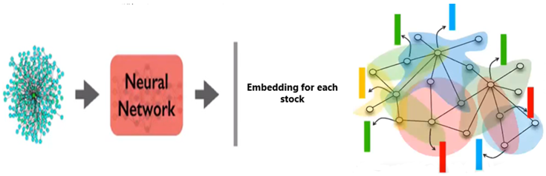
PROBLEM STATEMENT
Understanding network and topological structures of financial instruments have many applications in risk management, portfolio construction and trading strategies
Traditional techniques from network science involve creation of hand generated features like centrality measures, connected components, average path length etc. to understand interconnectedness of these financial instruments
Here we are attempting to automate this feature extraction process by training a neural network model on a network of stocks (S&P 500 universe), to create embedding representation for each stocks.
4. These learnt embeddings can be used in many different downstream tasks e.g. using as features in machine learning models, structural analysis of a complex network, finding similar/dissimilar stocks within a sector or in different sectors, performing analogical inferences on learnt embeddings etc.

Slide 5
WORD EMBEDDINGS
THE INSPIRATION BEHIND STOCK EMBEDDINGS

Slide 6
INTRODUCTION TO WORD EMBEDDINGS
?
I am ______ the notes
READING
STUDYING
MEMORIZING
REVIEWING
WRITING
EXAMINING
ANALYSING
Rationale: If two unique words are frequently surrounded by similar sets of words when used in various sentences across a large corpus then those words tend to be related in their meaning
Objective: Predicting the center word given its surrounding words for all the sentences in a given corpus

Slide 7
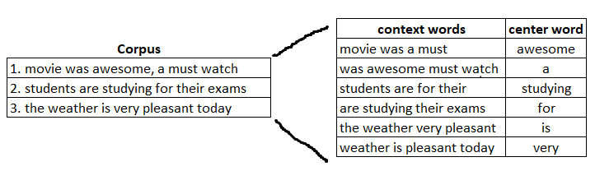
DATA PREPARATION
Identify a text corpus i.e., collection of documents for which we want to compute word embeddings
From the text corpus create sets of context words and center words using a moving window of fixed size
Context words will be a list of words with a fixed size of window size – 1, which will be used as features
Center word is the target variable that we will predict using the set of context words
CORPUS
movie was awesome and a must watch
Window size =5
Context Words C=2
CENTER WORD
movie was awesome and a must watch
CONTEXT WORDS
CONTEXT WORDS

Slide 8



METHODOLOGY
Create one hot encoding representation of all context words and center words
Create a shallow neural network with both input and output size as V i.e., total vocabulary size in the corpus. Here, N is number of neurons in the hidden layer, which is also embedding size of each words once model is trained
Train the model by minimizing categorical cross entropy and extract embeddings as average of the two trained weight matrices
Center
Word
Vector
Context
Word
Vector
Hidden Layer
Input size V (vocab size)
N number of neurons
Output size V (vocab size)
Input Layer
Output Layer
Figure: NEURAL NETWORK ARCHITECTURE

Slide 9
STOCK EMBEDDINGS
USING THE CONCEPT OF WORD EMBEDDINGS

Slide 10
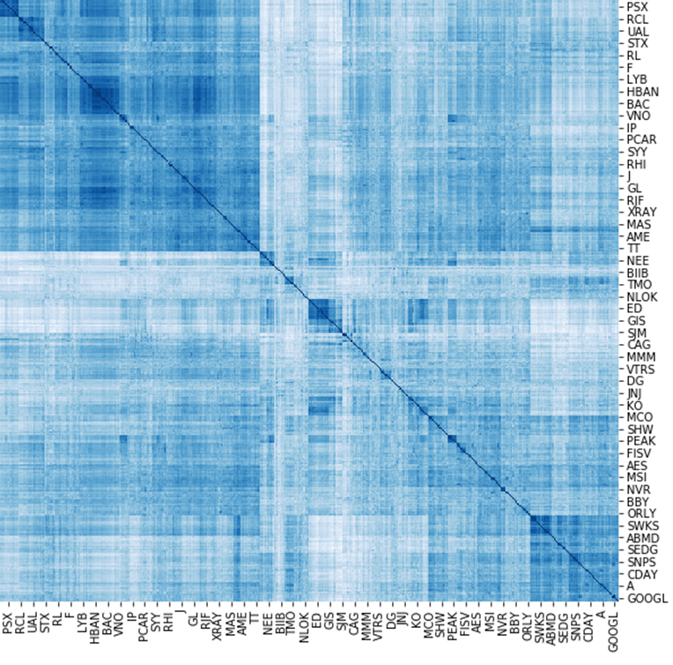
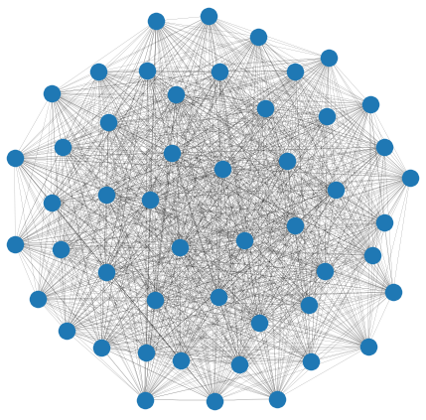
DATA PREPARATION
Compute log returns for S&P 500 universe for an entire year
Create correlation matrix of log returns for all the stocks in S&P 500
Create a network of stocks with each stock as a node and edge between stocks corresponds to correlation
1.00
0.75
0.50
0.25
0
-0.25
Figure: CORRELATION MATRIX OF LOG RETURNS OF S&P 500
Figure: FULLY CONNECTED NETWORK FROM CORRELATION MATRIX

Slide 11
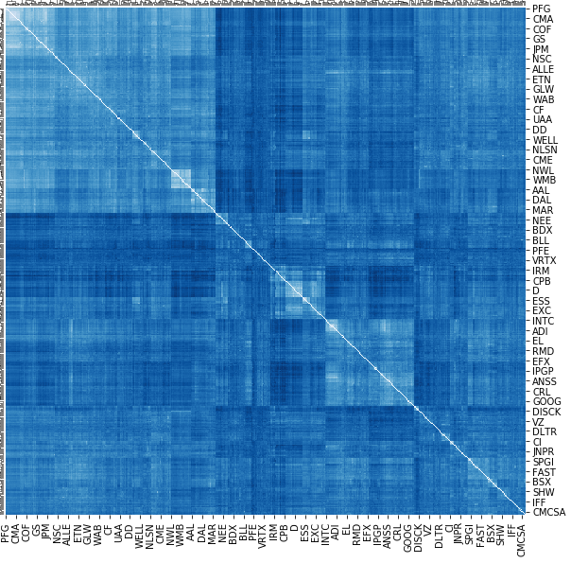

DATA PREPARATION
To remove noise network of stocks we convert correlation matrix into a distance matrix
Create a network of stocks from distance matrix
Apply minimum spanning tree (MST) on above network of stocks
1.00
0.75
0.50
0.25
0
-0.25
1.4
1.2
0.9
0.6
0.3
0
Figure: CORRELATION MATRIX OF LOG RETURNS OF S&P 500
Figure: DISTANCE MATRIX FROM CORRELATION MATRIX

Slide 12
DATA PREPARATION
Filter out noise from above network using Minimum Spanning Tree (MST)
Figure: FULLY CONNECTED NETWORK FROM DISTANCE MATRIX
Demo: MINIMUM SPANNING TREE

Slide 13
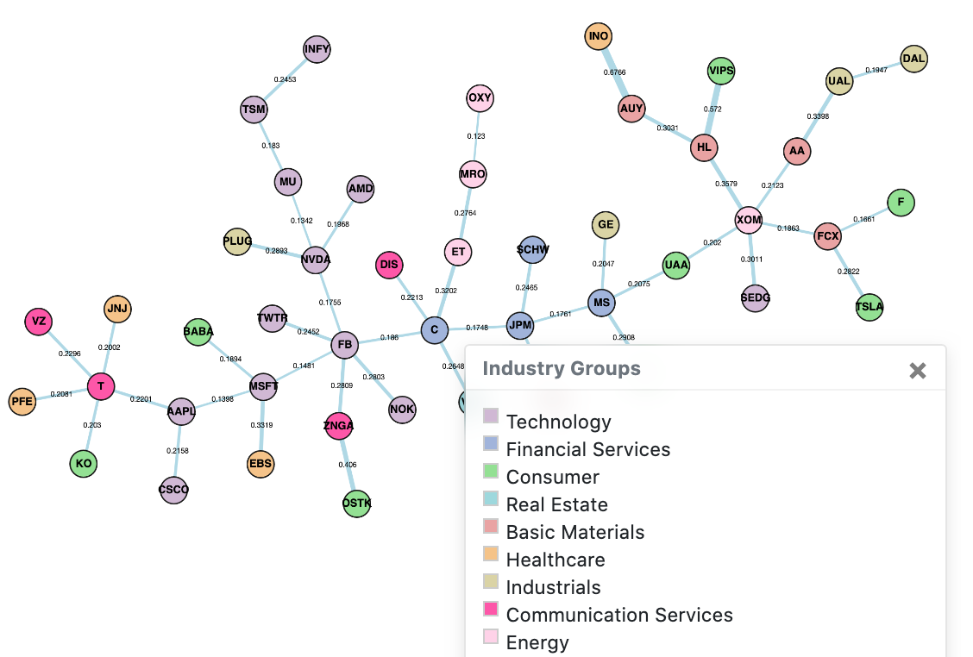
DATA PREPARATION
From fully connected correlation matrix to filtered network of stocks
1.00
0.75
0.50
0.25
0
-0.25
Figure: CORRELATION MATRIX OF LOG RETURNS OF S&P 500
Figure: NETWORK CONSTRUCTED USING MST

Slide 14
CREATING SENTENCE LIKE STRUCTURES FROM NETWORK
FB
C
ET
C
FB
MSFT
BABA
MSFT
AAPL
T
Create sentence like structure from this graph using random walk
Generate r random walks from each node in the graph
Each random walk has a fixed maximum length of l
Each walk is controlled by two parameters p and q

Slide 15
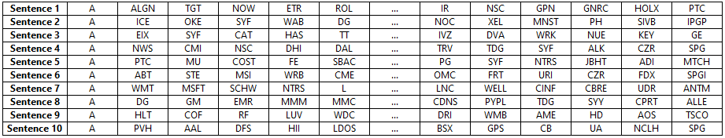
CREATING CONTEXT AND TARGET OF STOCKS
Once we get sentence like structures, then we create a set of context stocks and target stock by using a moving window of fixed size
Here we train a shallow neural network to predict target stocks using context stocks
Once model trained by minimizing categorical cross entropy loss, we extract stock embeddings as average of two weight matrices
CONTEXT STOCKS | TARGET STOCK
A, ALGN, NOW, ETR
TGT
ALGN, TGT, ETR, ROL
NOW
IR, NSC, GNRC, HOLX
GPN
NSC, GPN, HOLX, PTC
GNRC
A, ICE, SYF, WAB
OKE
ICE, OKE, WAB, DG
SYF

Slide 16
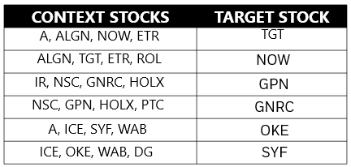
Training the embeddings
Context Stocks
Target Stock
Hidden Layer
Input size V (total number of stocks)
N number of neurons
Output size V (total number of stocks)
Input Layer
Output Layer

Slide 17
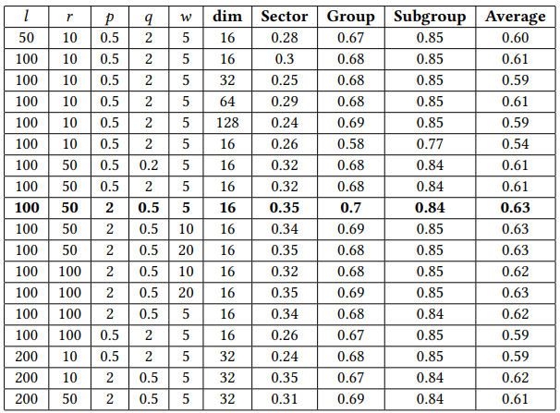
Quantitative Evaluation of Embeddings
We created clusters of stocks using the learnt embeddings and evaluated against GICS categories using V-Measure
hyperparameters | definition
𝑙 | the length for each random walk from each node in the network
𝑟 | the number of random walks from each node in the network
𝑝 | the probability with which a random walk will return to the node it visited previously
𝑞 | the probability with which a random walk will explore the unexplored part of the graph.
w | maximum distance between the current and predicted word within a sentence
dim | the dimensionality of the stock vectors

Slide 18
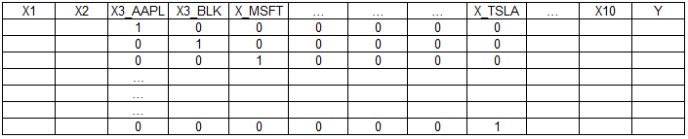
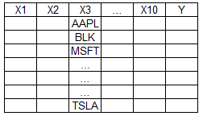
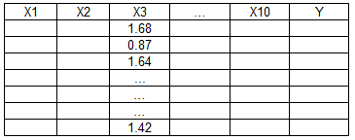
USE CASES
Use Case 1: Learnt embeddings can be used as a feature for downstream analytics
Traditional approach
Embeddings approach
Similarly these embeddings can be learnt for sectors, broker-dealers etc.

Slide 19


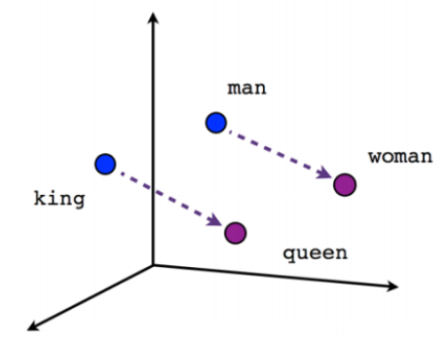
USE CASES
Use Case 2: Analogical Inferences
Analogical inferences can be very useful in an investment context when investors wish to extend their portfolios into different sectors in which they have little or no investment experience and/or to improve their portfolio diversity and limit overall risk and volatility
IF MAN:: WOMAN THEN KING::?
IF JPM:: GS THEN MSFT::?
IF JPM:: GS THEN JNJ::?
MOST SIMILAR | VALUE
GOOGL | 0.882
GOOG | 0.865
FB | 0.864
AAPL | 0.863
VRSN | 0.845
AMZN | 0.825
ADBE | 0.768
COST | 0.750
MSCI | 0.741
WMT | 0.722
MOST SIMILAR | VALUE
AMGN | 0.837
BMY | 0.826
LLY | 0.813
PFE | 0.793
PG | 0.792
ABBV | 0.791
MRK | 0.786
CL | 0.785
BIIB | 0.762
GILD | 0.761
Source

Slide 20
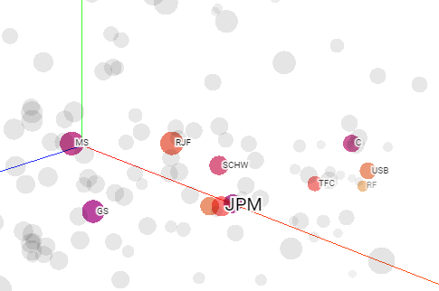
USE CASES
Use Case 3: Identifying Nearest Neighbors
Stock recommendation system can generate a ranked list of similar stocks based on their historical returns data for a given stock
The ability to identify maximally dissimilar stock is an important way to improve portfolio diversity in order to provide an investor with an ability to guard against volatility and hedge against sudden sectoral shocks.
STOCKS MOST SIMILAR TO JPM
MOST SIMILAR TO JPM | VALUE
GS | 0.955
C | 0.934
BAC | 0.918
MS | 0.917
SCHW | 0.894
RJF | 0.892
TFC | 0.828
USB | 0.799
NTRS | 0.792
WFC | 0.750

Slide 21
FUTURE RESEARCH AND REFERENCES
Use of different alternative datasets to compute correlation matrices for stocks
Use of different network filtering algorithm like PMFG, Random Matrix Theory etc.
Use of different algorithm for creating sentence like structures like deep walk instead of random walk etc.
Use of training dataset at a different frequency instead of end-of-day frequency
Quantitative evaluation of learnt embeddings
There is no standardized extrinsic evaluation of learnt embeddings
Traditional way is to evaluate embeddings on a downstream task, but research shows they are not consistent and sustainable
REFERENCES
Learning Embedded Representation of the Stock Correlation Matrix using Graph Machine Learning

Slide 22
QUESTIONS

